Slide 1
Building real-time data processing and model inferencing platform with Kafka Streams
Navinder Pal Singh Brar

Slide 2
ML @ Walmart
Personalization
Fraud detection
Display advertisement
Email advertisement
Omnichannel reorder
Autosuggest for out of stock products
Delivery Optimization
Smart pricing
Inventory Forecasting
Voice Commerce

Slide 3
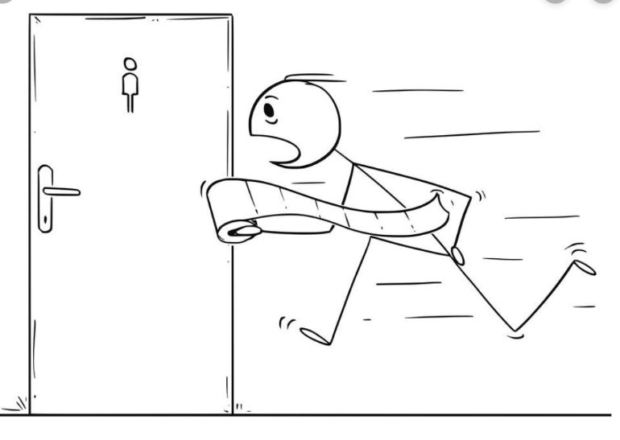
Business understanding
Data Collection
Data Preparation
Exploratory Data Analysis
Modelling
Model Evaluation
Model Deployment
Remaining 30-40% to make it production ready with help of developers
Data Science Model Life cycle
50% + time spending in data collection and cleaning activity
Courtesy: http://www.oogazone.com, https://www.vectorstock.com

Slide 4
Mission Statement
Build a platform to process events, derive inferences and serve knowledge
Reliable, highly available and scalable
High throughput and low latency
Universal feature store across models
Pluggable design to onboard new models
Reduce dev to prod time

Slide 5
Customer Backbone - CBB
Distributed streams processing platform built on Kafka Streams
Data scientists can bring their trained models and host them on top of CBB, which takes care of
Data Ingestion
Data Transformation
Feature Extraction
Model Inferencing/Scoring
Post Processing
Motto: Depth, Freshness & Reach

Slide 6
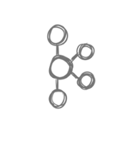
CBB Data Pipeline
Partition: 1
CBB Platform
Partition: 0
Recommendation
Kafka Streams
Kafka Streams
Personalization
Fraud Detection
CBB
Internal Kafka
….

Slide 7
Why Streams?
Other alternatives
Simple
Library, not a framework
Embedded DB
Interactive Queries
Highly scalable
DSL/Low Level APIs
At least/Exactly once guarantees
Apache Samza
Apache Spark
Apache Flink
Dynomite

Slide 8
Multitenancy: the challenges
1
Sequential execution of tenant models
3
Any model upgrade requires JVM restart
2
4
Any corrupt model can bring down the JVM
Client Isolation

Slide 9
CBB Data Pipeline
CBB Platform
Recommendation
Kafka Streams
Personalization
Fraud Detection
CBB
Internal Kafka
….

Slide 10
CBB Internals
After
Before
CBB Processor
Model A
A store
Model A
Model B
Model C
Model B
B store
CBB Store
A store
B store
C store
Model C
C store
KIP-408: Add Asynchronous Processing To Kafka Streams

Slide 11
Multitenancy: the solution
Process events and update CBB stores
Different clients can pull events at own pace
Appropriate sharing and isolation

Slide 12
Data Model
Tenant Stores
Platform Store
1. Linkages –customer graph
2. Events – customer interactions
3. Address – Addressable entities
4. Facets – customer features
Platform Store
Hop-On Store
LEAF Store
Sequence Store

Slide 13
Sequence Store
CBB Processor writes here
Sequence Store
0
1
2
3
4
5
6
7
8
9
10
11
…
…
…
…
Model A
(offset=3)
Model B
(offset=8)

Slide 14
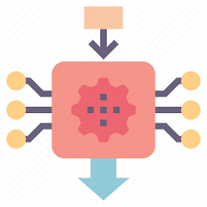
Model Inferencing
Mleap Runtime
Provides production level scoring infrastructure independent on the core libraries
Execute Spark ML Pipelines without the dependency on the spark context
Execute Scikit-learn pipelines without the dependency on numpy, pandas
Data scientists use various machine learning libraries and need to support them in production e.g. Spark ML, Scikit-learn, Tensorflow
Problem
Solution

Slide 15
Global Datastores
Global Topic
App Cluster
VM 1
VM 2
VM 3
VM 4

Slide 16
Global Datastores
Global data e.g. product catalog
One copy of global store per jvm
Processing global topics doesn't work with huge data
Global data is required before an active task moves to a VM
Create global stores in a different Kafka streams app and bootstrap each jvm on update
Problem
Solution

Slide 17
Walmart Scale
100 million weekly customers in stores
100 million unique monthly visitors @Walmart.com
55 banners including Jet.com, Hayneedle
11000 stores in 27 countries
Source: https://corprate.walmart.com/our-story/our-business

Slide 18
Identity Graph Processing
Problem:
Link different id’s data together when they are identified to be same person
Solution: Real time Identity Graph Conflation.
Aims to provide a coherent view of a customer by building an identity graph uniting all customer identities across channels and across Walmart subsidiaries

Slide 19
Customer Identity Graph
Graph processing co-locates the data of two or more customer identities linked to each other on the same physical node.
id1
id2
id6
id1
id2
=
id5
id3
id3
id4
id5
id6
id4
Node A
Node B
Node A

Slide 20
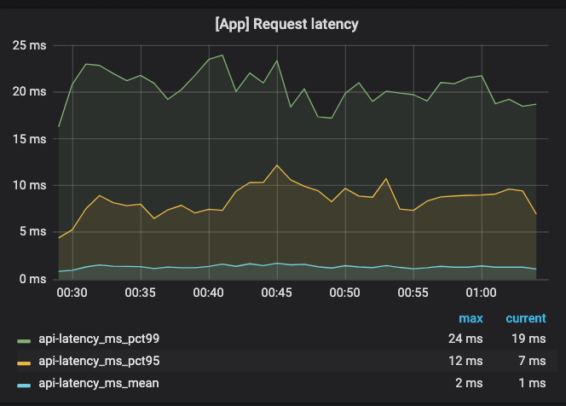
Benchmarks
Kafka Cluster : 400 cores
Kafka Streams : 800 cores

Slide 21
Benefits
^{Money}
^{Time}
^{Effort}
^{Minimal duplication}
^{Low Latency}
^{Reduces maintenance overhead}
Courtsey: https://www.vectorstock.com

Slide 22
Thank You!
navinderpalsinghbrar

